Slide 1
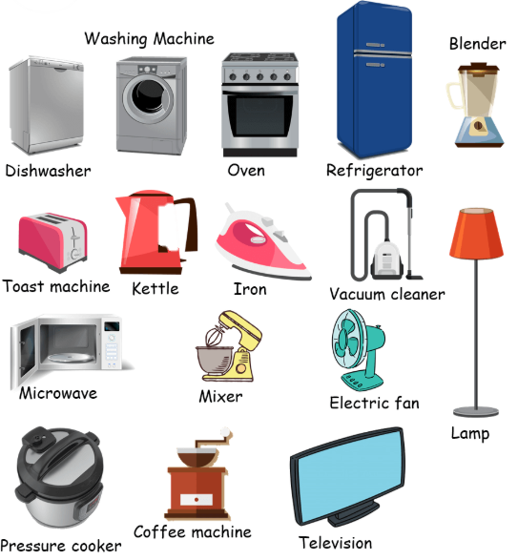
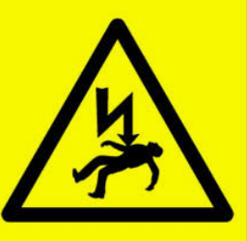
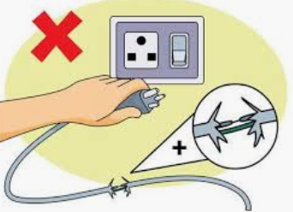
Electricity – Year 4
Electricity is a type of energy.
-It is used to power lots of different things, including many items that we use in everyday life.
-Electricity can flow through wires and cables, and can be stored in batteries (sometimes called cells).
-Electricity can flow in simple series electrical circuits.
Conductors – allow electricity to flow through them
Insulators – do not allow electricity to flow through them
Electricity can be created in different ways:
Burning fossil fuels
Using solar power generated by the sun
Using wind power (wind turbines)
Using water power (hydropower)
Electrical safety
Electricity can be extremely dangerous is it is not used safely.
Important electrical safety tips:
Do not put fingers and other objects in outlet
Never use anything with a cord or plug around water
Keep metal objects away from toasters
Stay away from power stations and lines
Never pull a plug out by its cord
Go indoors when it is thunder and lightning
Key vocabulary within a circuit
Circuit | The path the electric current follows. It must have no breaks in it for electricity to flow through.
Current | This is the electricity flowing through the circuit.
Battery (cell) | Where electricity can be stored.
Wire/Cable | Thin, flexible threads that transport electricity

Slide 2
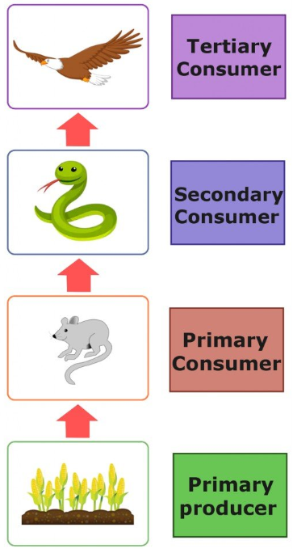
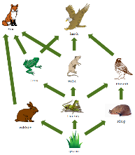
Animals including humans – Year 4
-Animals cannot create their own food, they must eat in order to get nutrition. Because of this, animals are called consumers.
-Animals and humans need the right types and amounts of nutrition.
-Nutrition groups include carbohydrates, fats, proteins, fibre, vitamins and minerals.
-Skeletons are important for support, movement and protection. Muscles help us to move and keep our posture.
Food Chains
Food chains show how each living things gets food and how nutrients are passed from producers through different consumers.
Food chains begin with plant life and end with animal life.
Producers are able to make their own food (for example plants, through photosynthesis).
Primary consumers are animals that eat producers.
Secondary consumers are animals that eat primary consumers.
Tertiary consumers are animals that eat secondary consumers.

Slide 3
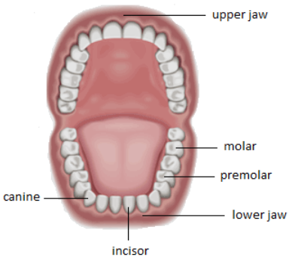
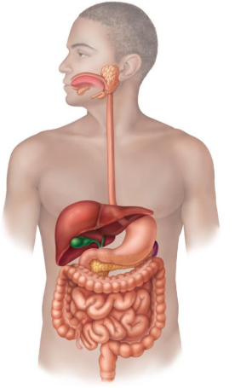
Animals including humans – Year 4
Digestive System
There are 3 main stages of the digestive system:
Ingestion – the food is taken in by the mouth and broken down by teeth and saliva.
Absorption – food is broken down in the stomach and intestines. Nutrients are absorbed into our bodies through the blood.
Excretion – Wasted food that the body doesn’t need is sent to the anus for excretion.
Teeth
Humans have up to 32 adult teeth, made up of 4 different types. Each of these types have an important job.
Mouth
Oesophagus
Liver
Stomach
Incisors | They are used to cut food.
Canines | They are used to tear food.
Pre-molars | They are used to crush food.
Molars | They are used to grind food.
Pancreas
Large intestine
Small intestine
Anus

Slide 4
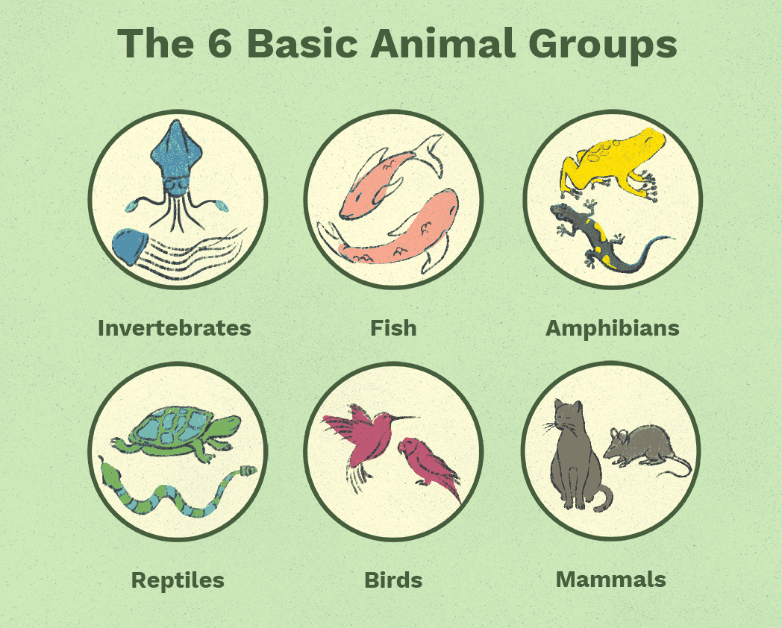
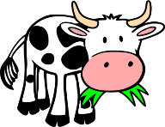
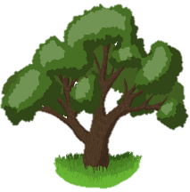
Living things and their habitats – Year 4
Living things can be grouped in different ways
Living things can be grouped and compared based on their features and habitats
Environments can change and this can sometimes pose danger to living things
Classification keys can be used to help group, identiy and name living things in their local environment
Characteristics of living
M | Movement | Animals move in many different ways. Plants grow and turn towards light
R | Respiration | Plants and animals use oxygen in the air to turn food into energy.
S | Sensitivity | Living things can detect changes in their surroundings.
G | Growth | Living things get bigger and grow.
R | Reproduction | Animals have young. Plants create seeds from which new plants grow
E | Excretion | Living things get rid of things that they make but don’t need.
N | Nutrition | Living things need food/nutrients for energy.
Habitats
A habitat is a home environment for plants, animals, and other living things.
-Examples of habitats include:
-Desert; Rainforest;
-Woodland; Ocean;
-Meadow; Seashore.
Habitats contain features that make them suitable to the things that live there, e.g., food, shelter, or temperature.
Habitats can change over the year & over time, so some animals migrate.

Slide 5
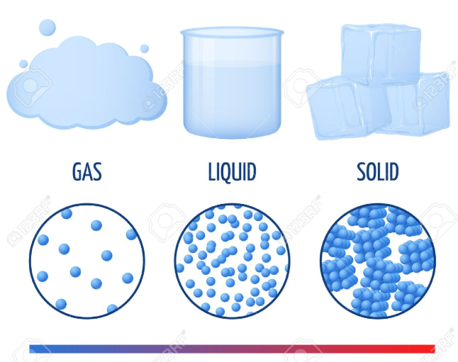
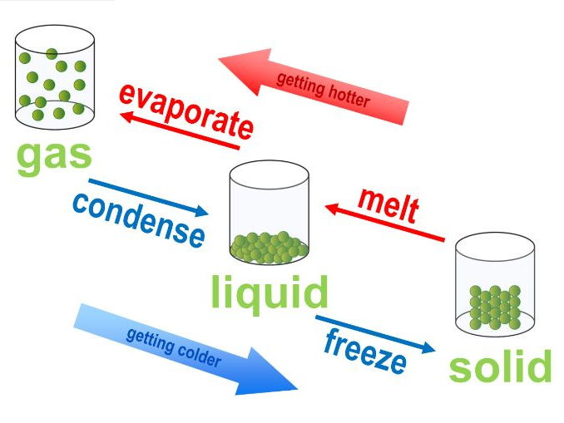
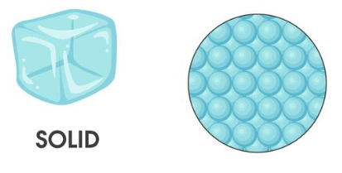
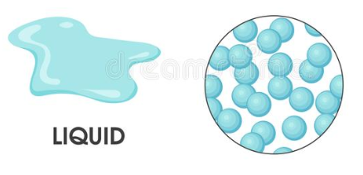
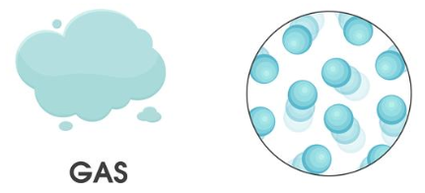
Materials – Year 4
(States of Matter)
Matter makes up our planet and the whole Universe.
There are three main states of matter – solids, liquids and gases.
Matter can change state, depending on its temperature.
The water cycle depends upon some of these processes.
Solids, Liquids and Gases
Solids | Hold their shape They are rigid They have a fixed volume Examples: ice cubes, rock, glass, most metals
Liquids | Do not hold their shapes They are not rigid They have a fixed volume Examples: water, oil, blood, milk
Gases | Do not hold their shape They are not rigid They do not have a fixed volume Examples: oxygen, carbon dioxide, helium
States of matter can change, depending upon the temperature of the matter.
Melting is the process of changing a solid into a liquid.
Evaporation is the process of changing a liquid into a gas.
Condensation is the process of changing a gas into a liquid.
Freezing is the process of turning a liquid into a solid.

Slide 6
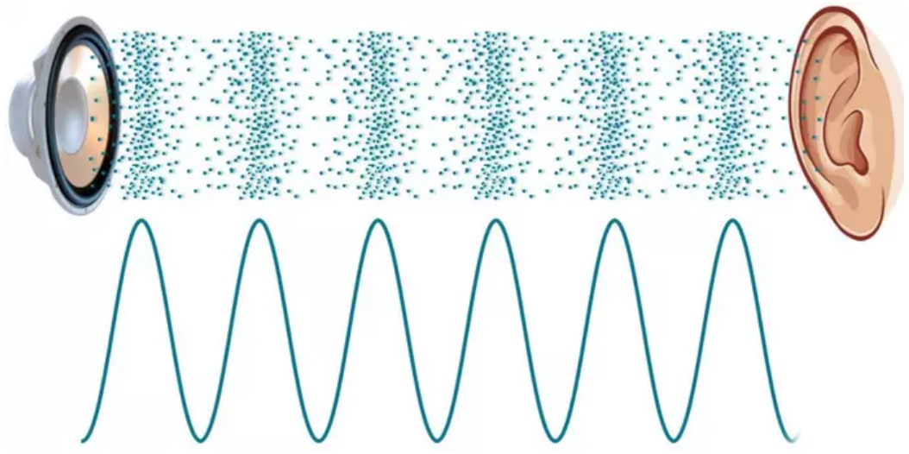
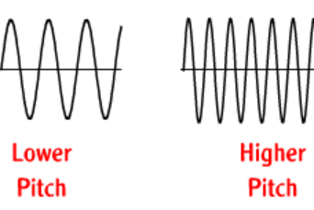
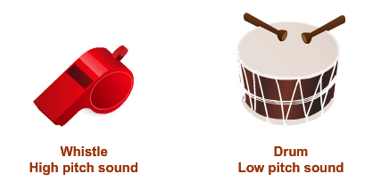
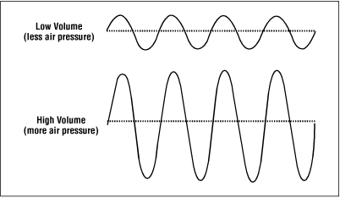
Sound – Year 4
How sounds are made: -Sounds are created when something vibrates (shakes back and forth). -This creates soundwaves which travel to the ears of the listener. -When a bell is struck, the metal of the bell vibrates. These vibrations create waves in the air (sound waves). -When they reach our ears, they make our eardrums vibrate, and we hear the sound of the bell ringing.
Pitch - how high or low the sound of something is.
Volume – how loud the sound of something is.
Pitch is caused by the frequency of vibrations (how many times vibrations go back and forth per second).
The volume of a sound depends on the amount of energy that the vibrations contain.

